Slide 1
System Development Methods CT00046-3-2
Activity Diagram
Tutorial 11 – Part 2

Slide 2
Tutorial
Create an activity diagram for the ‘Login’ process in the SAS case study.
See the next slide to find out the SAS requirements.

Slide 3
Student Application System (SAS) Case Study
You would like to create an online portal for prospective students to apply for programs at universities. There will be a list of universities in the portal for students to select from. Each university offers several programs of study. Applicants should be able to create a profile of themselves. When they are interested in a program, they will submit an application. The registry staff at the related university will first validate that the required information in the application. If the application is valid, the head of the department (HOD) of the program will approve or reject the application.

Slide 4
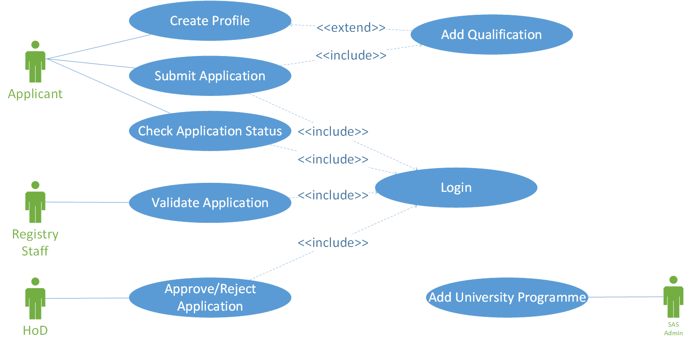
The Proposed Use Case Diagram ‘Login’ is one of the use cases in the SAS

Slide 5
Activity Diagram Definition
An activity diagram is a behavioral diagram that describes series of actions in a system, likewise a flowchart.
Can be used to describe details steps of certain use case, that is included in a use case diagram.

Slide 6
Activity Diagram Symbols
Activity/Action Represent action of object in your system. You can illustrate an activity by using a rectangle with rounded corners.
Swimlane Used to group related activities into one column

Slide 7
Activity Diagram Symbols
Transition A solid arrow represents the path between different actions of an object.
Initial Node A filled circle followed by an arrow represents the object's initial activity.
Final Node An arrow pointing to a filled circle nested inside another circle represents the object's final activity.

Slide 8
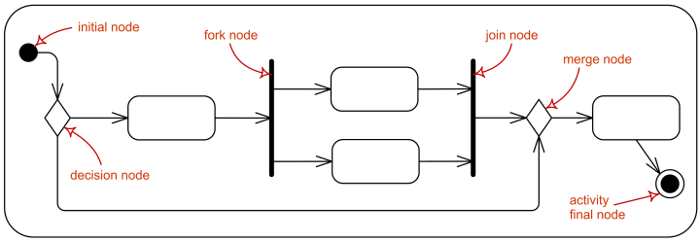
Activity Diagram Symbols
Synchronization and Splitting of Control A short heavy bar with two transitions entering it represents a synchronization of control.
The first bar is often called a fork where a single transition splits into concurrent multiple transitions.
The second bar is called a join, where the concurrent transitions reduce back to one.

Slide 9
Let’s create an activity diagram for the ‘Login’ process in the SAS case study.
Use of system modelling tool e.g., Ms. Visio, DIA, draw.io, etc.

